Slide 1
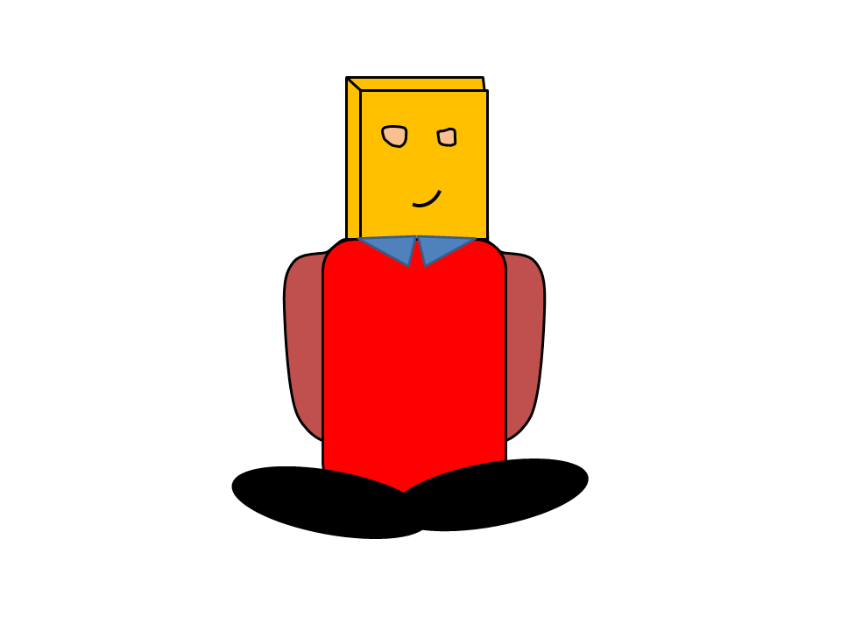
Work of 100 people
Alone!

Slide 2






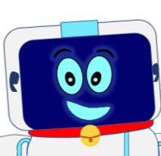

Apps that use python in some way
100’s of messages
In seconds
You can even make Jarvis from Iron Man with Python
It also makes great backend for websites
Python is great for automation tasks

Slide 3

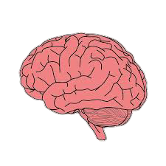
Adding brain to robots
Python is used widely for machine learning .

Slide 4
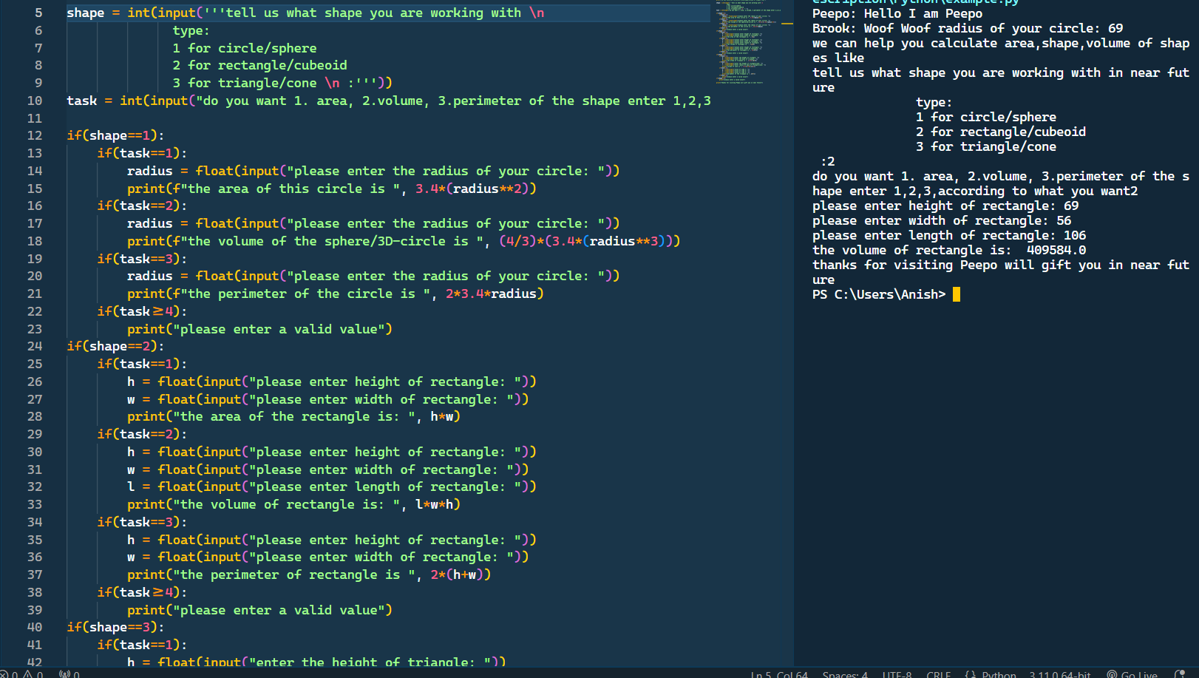
No matter how complex the software is,
python syntax always remains ,
Readable, User/beginner-friendly
This simple program can measure perimeter , area or volume of any circle , rectangle or triangle
Try if you can read it

